Slide 1
Deep Learning Reading Group
Week 4

Slide 2
Convolution Operation
Source: https://medium.datadriveninvestor.com/convolutional-neural-networks-3b241a5da51e?gi=10000de66771

Slide 3
Padding and Stride
Source: https://towardsdatascience.com/what-is-transposed-convolutional-layer-40e5e6e31c11

Slide 4
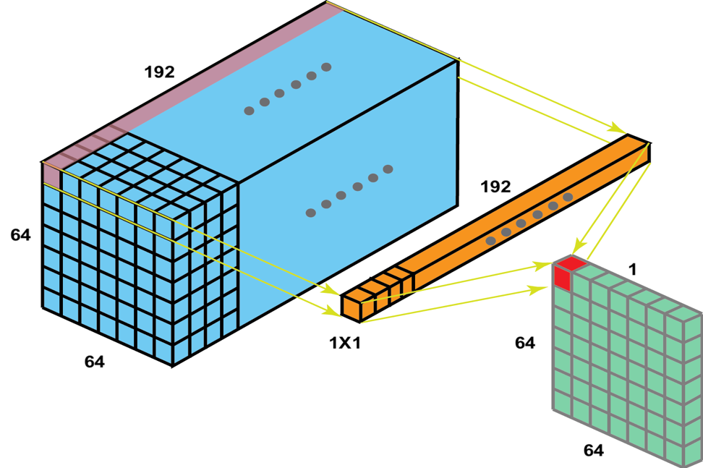
1x1 Convolution
Source: https://medium.com/analytics-vidhya/talented-mr-1x1-comprehensive-look-at-1x1-convolution-in-deep-learning-f6b355825578

Slide 5
Pooling
Source: https://nico-curti.github.io/NumPyNet/NumPyNet/layers/maxpool_layer.html

